Slide 1
15. Exception Handling
[ECE20016/ITP20003] Java Programming
Notes:
‹#›

Slide 2
Agenda
Basic Exception Handling
Defining Your Own Exception Classes
More About Exception Classes

Slide 3
Exceptions in Java
An exception is an object that contains an error data and related actions.
Signals the occurrence of unusual event during program execution that can be handled. e.g.,
NullPointerException, IndexOutOfBoundException,...
Throwing an exception when it happens
We can define our own erroneous situation by throwing our own exception.
Throwing an exception means creating the exception object.
Handling the exception
Code that detects and deals with the exception.

Slide 4
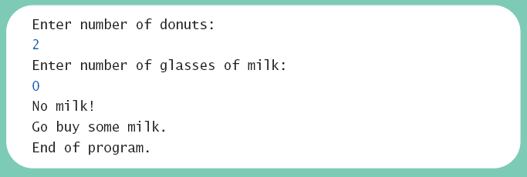
Exceptions in Java
Consider a program to assure us of a sufficient supply of milk.

Slide 5
A Possible Solution
Scanner keyboard = new Scanner (System.in);
System.out.println ("Enter number of donuts:");
int donutCount = keyboard.nextInt ();
System.out.println ("Enter number of glasses of milk:");
int milkCount = keyboard.nextInt ();
//Dealing with an unusual event without Java's exception handling features:
if (milkCount < 1) {
System.out.println ("No milk!");
System.out.println ("Go buy some milk.");
} else {
double donutsPerGlass = donutCount / (double) milkCount;
System.out.println (donutCount + " donuts.");
System.out.println (milkCount + " glasses of milk.");
System.out.println ("You have " + donutsPerGlass +
" donuts for each glass of milk.");
}
System.out.println ("End of program.");
https://github.com/lifove/ExceptionExamples/blob/master/src/main/java/edu/handong/csee/java/exception/examples/SupplierWithoutExceptionHandling.java

Slide 6
Exceptions in Java
Now we revise the program to use exception-handling
try {
System.out.println ("Enter number of donuts:");
int donutCount = keyboard.nextInt ();
System.out.println ("Enter number of glasses of milk:");
int milkCount = keyboard.nextInt ();
if (milkCount < 1)
throw new Exception ("Exception: No milk!");
double donutsPerGlass = donutCount / (double) milkCount;
System.out.println (donutCount + " donuts.");
System.out.println (milkCount + " glasses of milk.");
System.out.println ("You have " + donutsPerGlass +
" donuts for each glass of milk.");
} catch (Exception e) {
System.out.println (e.getMessage ());
System.out.println ("Go buy some milk.");
}
System.out.println ("End of program.");
https://github.com/lifove/ExceptionExamples/blob/master/src/main/java/edu/handong/csee/java/exception/examples/Supplier.java

Slide 7
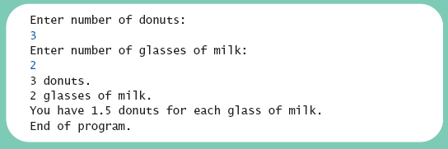
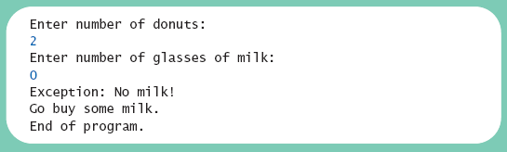
Exceptions in Java
Output

Slide 8
Exceptions in Java
Predefined Exceptions in Java
Public method calls or accessing data can throw predefined exceptions.
e.g., IndexOutOfBounds esception when using arrays.
Customized Exceptions by each developer.

Slide 9
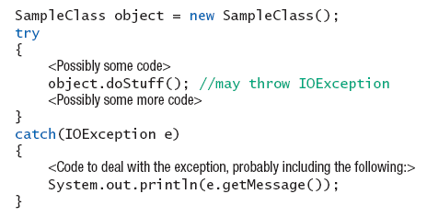
Predefined Exception Classes
Ex)

Slide 10
Exceptions in Java
Note try block
Contains code where something could possibly go wrong
If it does go wrong, we throw an customized exception or method calls or data access we are using in the try block will throw a predefined exception.
Note catch block
When exception thrown, catch block begins execution
Similar to method with parameter
Parameter is the thrown Exception object

Slide 11
Predefined Exception Classes
Java has predefined exception classes within Java Class Library
Can place method invocation in try block
Follow with catch block for this type of exception
Example classes
NullPointerException
ArrayOutOfBoundException
BadStringOperationException
ClassNotFoundException
IOException
NoSuchMethodException

Slide 12
Agenda
Basic Exception Handling
Defining Your Own Exception Classes
More About Exception Classes
Graphics Supplement

Slide 13
Defining Your Own Exception Classes
Must be derived class of some predefined exception class
Text uses classes derived from class Exception
Ex)
public class DivideByZeroException extends Exception
{
public DivideByZeroException ()
{
super ("Dividing by Zero!");
}
public DivideByZeroException (String message)
{
super (message);
}
}

Slide 14
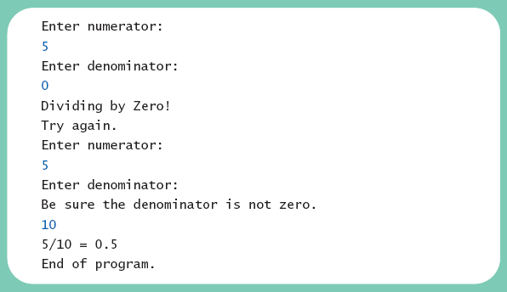
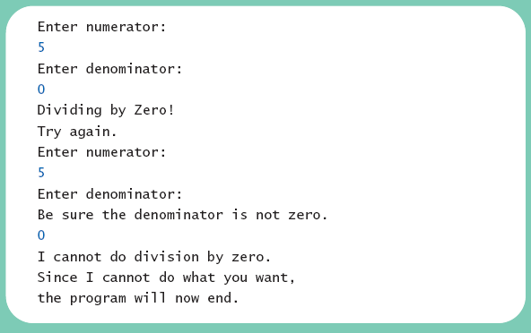
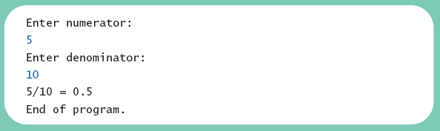
Defining Your Own Exception Classes
class DivideByZeroDemo
https://github.com/lifove/ExceptionExamples/tree/master/src/main/java/edu/handong/csee/java/exception/examples/dividebyzero
Different runs of the program

Slide 15
Defining Your Own Exception Classes
Note method getMessage defined in exception classes
Returns string passed as argument to constructor
If no actual parameter used, default message returned
The type of an object is the name of the exception class

Slide 16
Defining Your Own Exception Classes
Guidelines
Use the Exception as the base class
Define at least two constructors
Default, no parameter
With String parameter
Start constructor definition with call to constructor of base class, using super
Do not override inherited getMessage

Slide 17
Agenda
Basic Exception Handling
Defining Your Own Exception Classes
More About Exception Classes
Graphics Supplement

Slide 18
Declaring Exceptions
Sometimes, it makes sense to delay handling of an exception.
A method can pass an exception to its caller.
Method that does not catch an exception
Must notify programmers with throws clause
Programmer then given responsibility to handle exception
Note distinction
Keyword throw used to throw exception
Keyword throws used in method heading to declare an exception

Slide 19
Declaring Exceptions
Note syntax for throws clause
Indicates that the method may throw exceptions
Ex)
public void sampleMethod() throws DivideByZeroException
{
…
}

Slide 20
Declaring Exceptions
If a method throws exception and exception not caught inside the method
Method ends immediately after exception thrown
A throws clause in overriding method
Can declare fewer exceptions than declared
But not more
class DoDivision
https://github.com/lifove/ExceptionExamples/blob/master/src/main/java/edu/handong/csee/java/exception/examples/dividebyzero/DoDivision.java

Slide 21
Kinds of Exceptions
In most cases, exception is caught …
In a catch block … or
Be declared in throws clause
But, Java has exceptions you do not need to account for

Slide 22
Kinds of Exceptions
Checked exceptions
Must be caught in catch block or declared in throws clause
Unchecked exceptions (run-time exception)
Need not be caught in catch block or declared in throws
Exceptions that indicates coding problems exist, should be fixed
Ex) Attempt to use array index out of bounds, Division by zero
Uncaught runtime exception terminates program execution

Slide 23
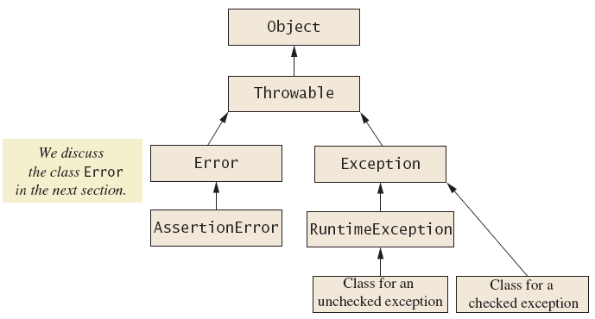
Kinds of Exceptions
Hierarchy of the predefined exception classes

Slide 24
Errors
An error is an object of class Error
Similar to an unchecked exception
Need not catch or declare in throws clause
Object of class Error generated when abnormal conditions occur
Errors are more or less beyond your control
Ex) OutOfMemoryError
Require change of program to resolve

Slide 25
Multiple Throws and Catches
A try block can throw any number of exceptions of different types
Each catch block can catch exceptions of only one type
Order of catch blocks matter
class TwoCatchesDemo
main() can throw NegativeNumberException
exceptionalDivision() can throw DivideByZeroException
https://github.com/lifove/ExceptionExamples/blob/master/src/main/java/edu/handong/csee/java/exception/examples/dividebyzero/TwoCatchesDemo.java
class NegativeNumberException
https://github.com/lifove/ExceptionExamples/blob/master/src/main/java/edu/handong/csee/java/exception/examples/dividebyzero/NegativeNumberException.java

Slide 26
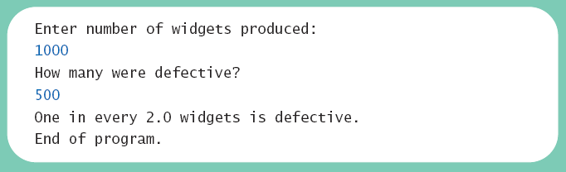
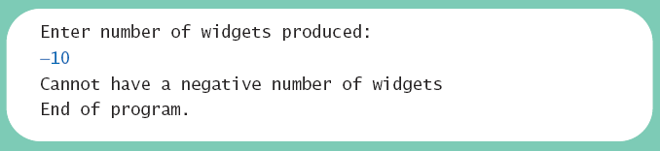
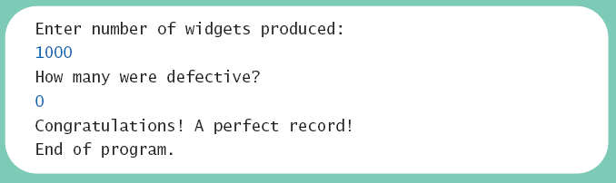
Multiple Throws and Catches
Note multiple sample runs

Slide 27
Multiple Throws and Catches
Exceptions can deal with invalid user input
To handle an exception thrown by a method
It does not matter where in the method the throw occurs
Use of throw statement be should be reserved for cases where it is unavoidable
Text suggests separate methods for throwing and catching of exceptions
Nested try-catch blocks rarely useful

Slide 28
The finally Block
Possible to add a finally block after sequence of catch blocks
try {
...
} catch(Exception e) {
...
} finally {
...
}
Code in finally block executed
Whether or not exception thrown
Whether or not required catch exists

Slide 29
Rethrowing an Exception
Legal to throw an exception within a catch block
Possible to use contents of String parameter to throw same or different type exception

